Slide 1
Internship Project Report
Web Development - Mass Mail Dispatcher
Prepared By
AJIT KUMAR
1BY22MC003
BMSIT&M

Slide 2
Abstract
"Mass-Mail Dispatcher: An Innovative Bulk Email Solution"
Web-based application revolutionizes bulk email dispatching.
Streamlines email distribution via CSV uploads.
Identifies and organizes valid/invalid emails for user convenience.
Empowers users with a structured interface for efficient dispatch.
Redefines mass-mailing with robust architecture and user-centric features.

Slide 3
"Introduction to Mass-Mail Dispatcher"
Addresses challenges in bulk email dispatching.
Revolutionizes email dissemination for efficiency.
Aims to simplify managing vast recipient lists.
Offers an intuitive, user-friendly platform.
Promises enhanced precision and convenience in email dispatch.

Slide 4
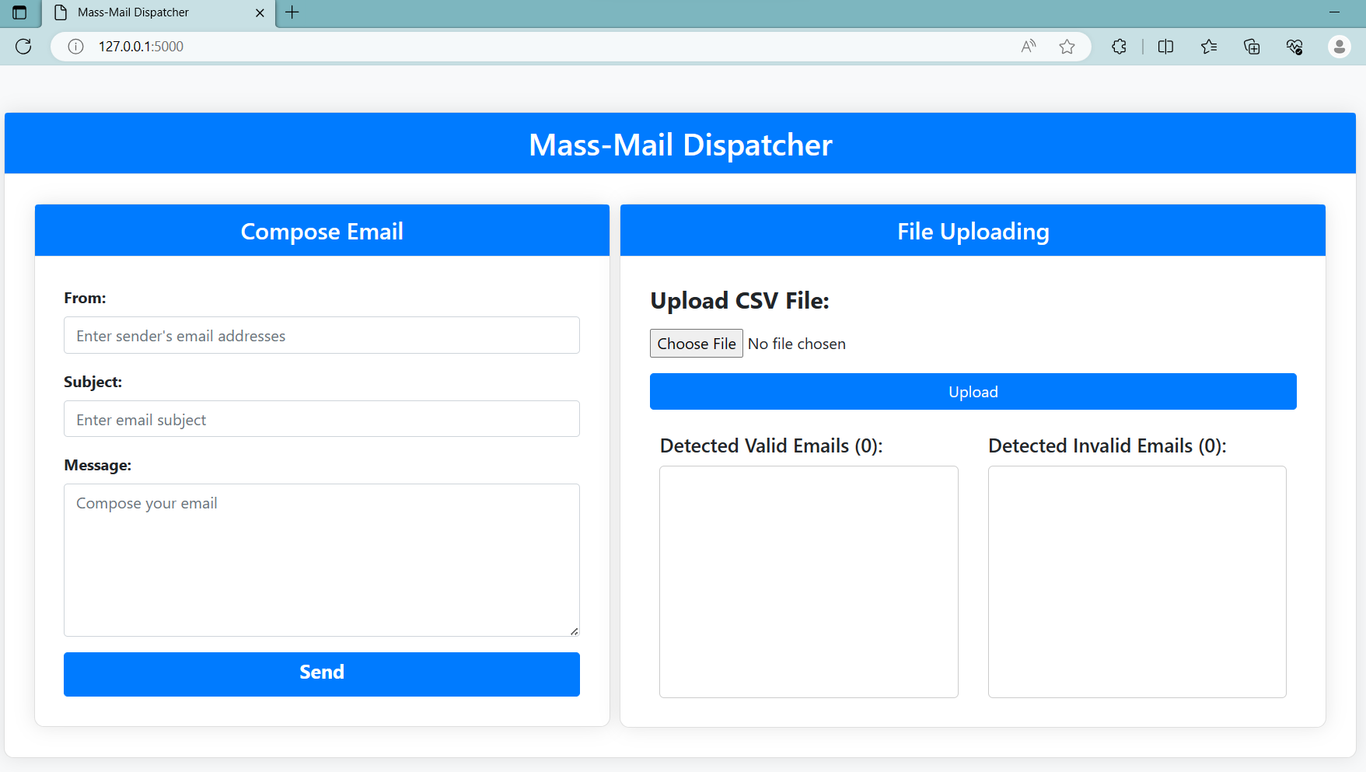
Implementation

Slide 5
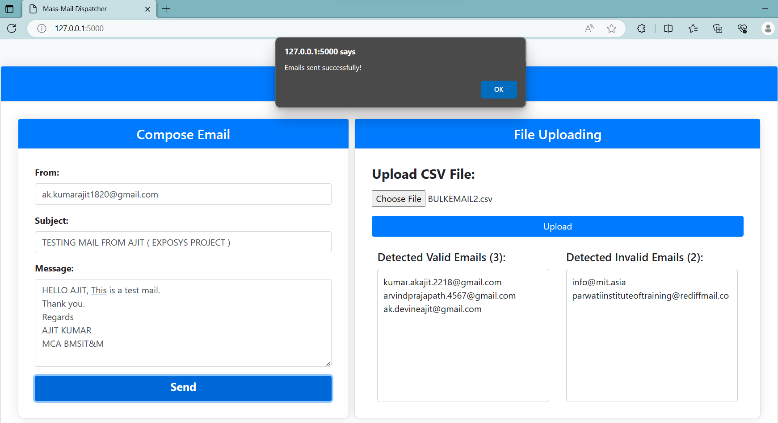

Slide 6
